Slide 1


CHAT ROOM APPLICATION USING SOCKET.IO
REVIEW -2 Computer Networks Project

Slide 2


Team Members
KAUSTUBH GUPTA (RA2011003010476)
PRATEEK (RA2011003010491)
AYUSH ABHIGYAN (RA2011003010493)
AFRAZ TANVIR (RA2011003010499)
SOHAM GHOSH (RA2011003010504)

Slide 3
Contents
PROJECT DEFINITION
ABTSRACT
PROJECT SCOPE
RELATION TO EXTERNAL ENVIRONMENT
LANGUAGES AND TOOLS USED
DESIGN CONSIDERATION
METHODOLOGY
FLOW CHART
DEMO OF THE WORKING OF CHAT ROOM
HARDWARE REQUIREMENT
SOFTWARE REQUIREMENT
CONCLUSION
REFERENCES

Slide 4
Project Definition
To make a chat room application where users can make their own room functionality where users can share the room with their friends to have text based communication.

Slide 5
ABSTRACT
We will use Node.js for the backend which will create rooms and handle the backend part of our application. Additionally we will use socket.io to enable real time communication between Client and server. Teleconferencing or Chatting, is a method of using technology to bring people and ideas “together” despite of the geographical barriers. The technology has been available for years but the acceptance it was quite recent. Our project is an example of a chat server. We created a real-time chat application with room functionality where you can create your own room and share the room name with your friends to have text-based communication.

Slide 6
Project Scope
Teleconferencing or Chatting, is a method of using technology to bring people and ideas “together” despite of the geographical barriers. The technology has been available for years but the acceptance it was quite recent. Our project is an example of a chat server. We created a real-time chat application with room functionality where you can create your own room and share the room name with your friends to have text-based communication.

Slide 7
Relation to External Environment
This tool helps in too major aspects-
List of the names of online users in the Room.
Used for communication between multiple systems enlisted in the list

Slide 8







Languages and Tools Used

Slide 9
Design Consideration
We will be using Node.js for the back end, which will be responsible for creating rooms and managing users in those rooms. Additionally, we will be using Socket.io to enable real-time, bidirectional communication between the web server and the client (browser).

Slide 10
Methodology
The user will interact with the tool using a GUI
The user enters a username and a room name
A room is created and it has a list form and a chat form
The list form contains the usernames of the people in the room
The chat form makes the actual communication possible in the form of text

Slide 11
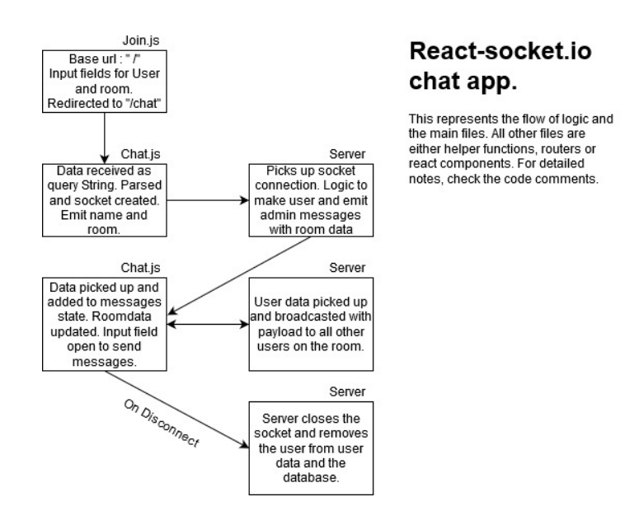
Flow Chart

Slide 12
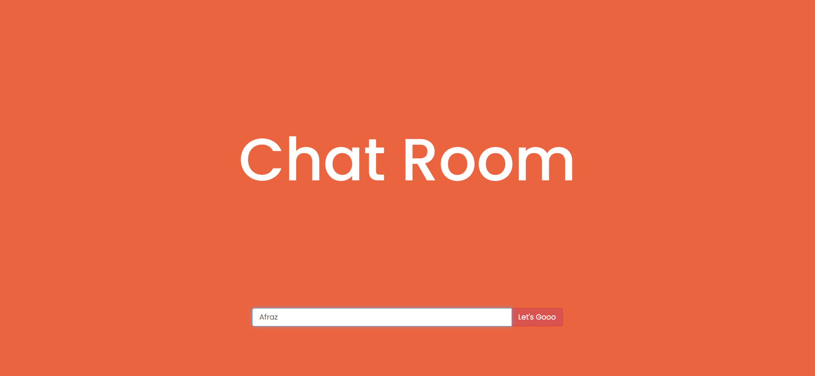
Demo of The working of Chat Room

Slide 13
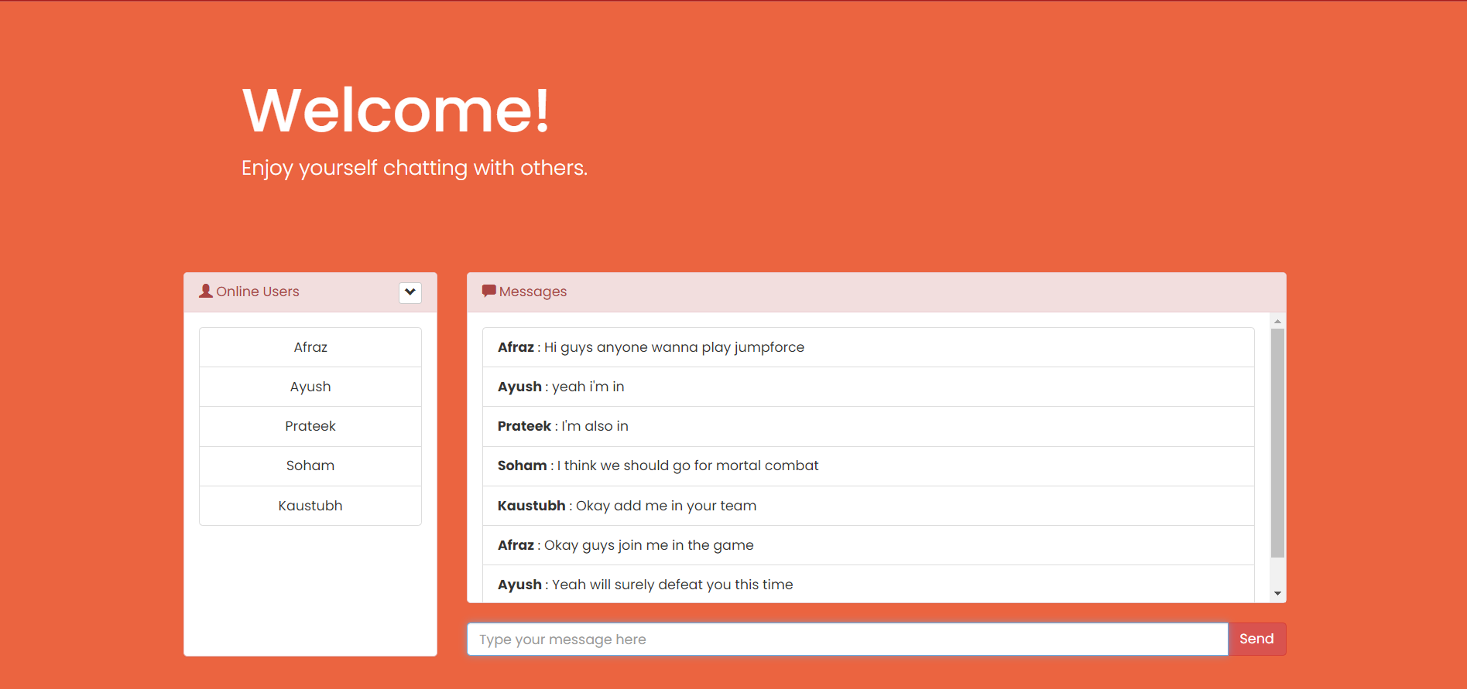
Demo of The working of Chat Room

Slide 14
Hardware Requirements
In hardware requirement we require all those components which will provide us the platform for the development of the project. The minimum hardware required for the development of this project is as follows
Ram- minimum 128 MB
Hard disk-minimum 5 GB
Processor-Pentium 3
Floppy drive 1.44” inch
CD drive
These all are the minimum hardware requirement required for our project. We want to make our project to be used in any. Type of computer therefore we have taken minimum configuration to a large extent.128 MB ram is used so that we can execute our project in a least possible RAM.5 GB hard disk is used because project takes less space to be executed or stored. Therefore minimum hard disk is used. Others enhancements are according to the needs.

Slide 15
Software Requirements
Software requirements Software’s can be defined as programs which run on our computer .it act as petrol in the vehicle. It provides the relationship between the human and a computer. It is very important to run software to function the computer. Various software’s are needed in this project for its development. Which are as follows
Operating system-Windows 7
Others-Visual Studio
We will be using visual basic as our front hand because it is easier to use and provides features to the users which is used for the development of the project.

Slide 16
Conclusion
A chat room application where users can make their own room functionality where users can share the room with their friends to have text based communication is constructed and deployed successfully.

Slide 17
References
MDN Docs
W3S Schools
Npm docs
Socket io.docs
Stackoverflow
Geeks for geeks

Slide 18
Thank You
KAUSTUBH GUPTA (RA2011003010476)
PRATEEK (RA2011003010491)
AYUSH ABHIGYAN (RA2011003010493)
AFRAZ TANVIR (RA2011003010499)
SOHAM GHOSH (RA2011003010504)

